Slide 1
虛擬化技術 Virtualization Technique
System Virtualization
Case Study

Slide 2
Agenda
VMware on x86
Xen on x86
KVM on x86
ARMvisor on ARM
CPU virtualization
Memory virtualization
I/O virtualization

Slide 3
vmware on x86

Slide 4
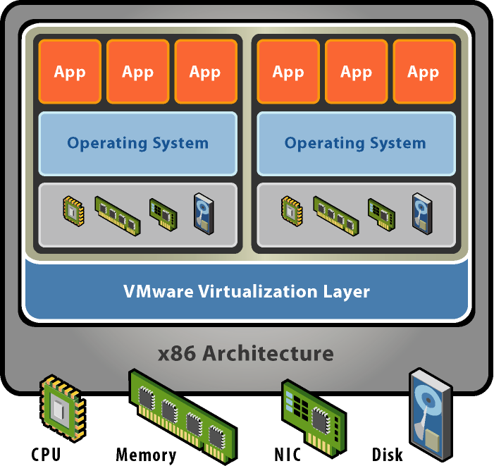
VMware
Basic properties :
Separate OS and hardware – break hardware dependencies
OS and Application as single unit by encapsulation
Strong fault and security isolation
Standard, HW independent environments can be provisioned anywhere
Flexibility to chose the right OS for the right application

Slide 5
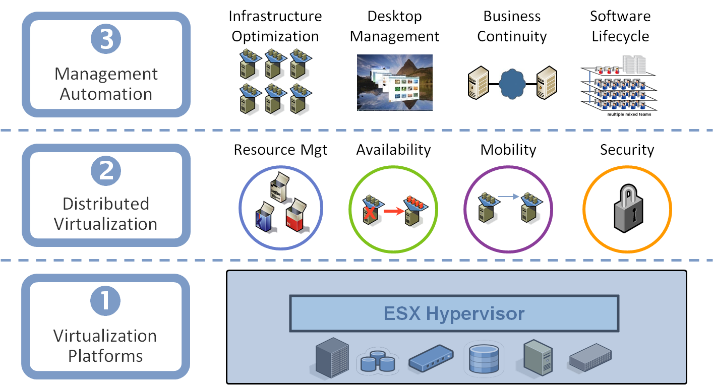
VMware Virtualization Stack

Slide 6
VMware Major Products
VMware Server
A free-of-charge virtualization-software server suite
Run multiple servers on your server
Hosted architecture
Available for Linux hosts and Windows hosts
VMware ESX Server
An enterprise-level computer virtualization product
Quality of service
High-performance I/O
Host-less architecture ( bare-metal )

Slide 7
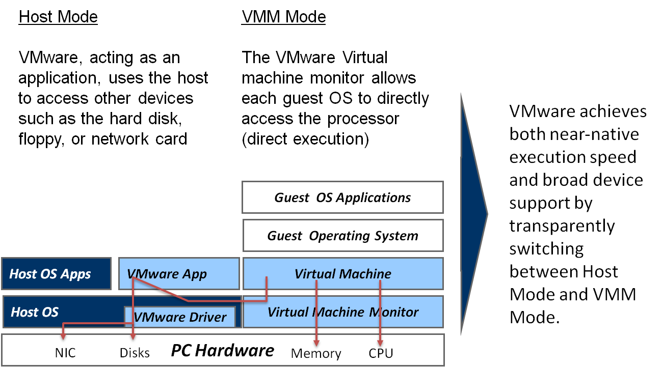
VMware GSX Server Architecture

Slide 8
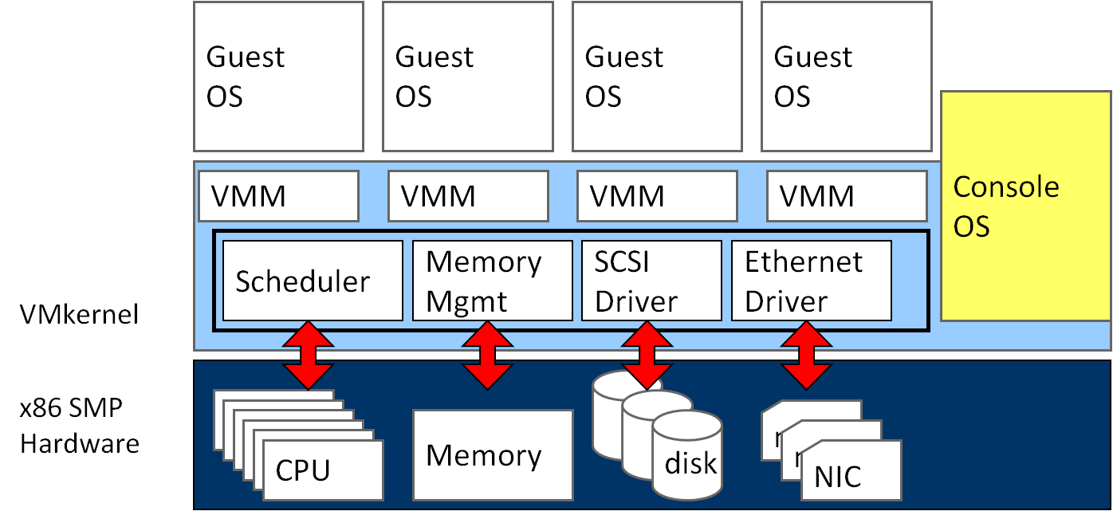
VMware ESX Server Architecture

Slide 9
XEN ON X86

Slide 10
Xen
Basic properties :
Para-virtualization
Achieve high performance even on its host architecture (x86) which has a reputation for non-cooperation with traditional virtualization techniques.
Hardware assisted virtualization
Both Intel and AMD have contributed modifications to Xen to support their respective Intel VT-x and AMD-V architecture extensions.
Live migration
The LAN iteratively copies the memory of the virtual machine to the destination without stopping its execution.
Implement system:
Novell's SUSE Linux Enterprise 10
Red Hat's RHEL 5
Sun Microsystems' Solaris

Slide 11
Para-virtualization in Xen
Xen extensions to x86 arch
Like x86, but Xen invoked for privileged instructions
Avoids binary rewriting
Minimize number of privilege transitions into Xen
Modifications relatively simple and self-contained
Modify kernel to understand virtualized environment
Wall-clock time vs. virtual processor time
Desire both types of alarm timer
Expose real resource availability
Enables OS to optimize its own behaviour

Slide 12
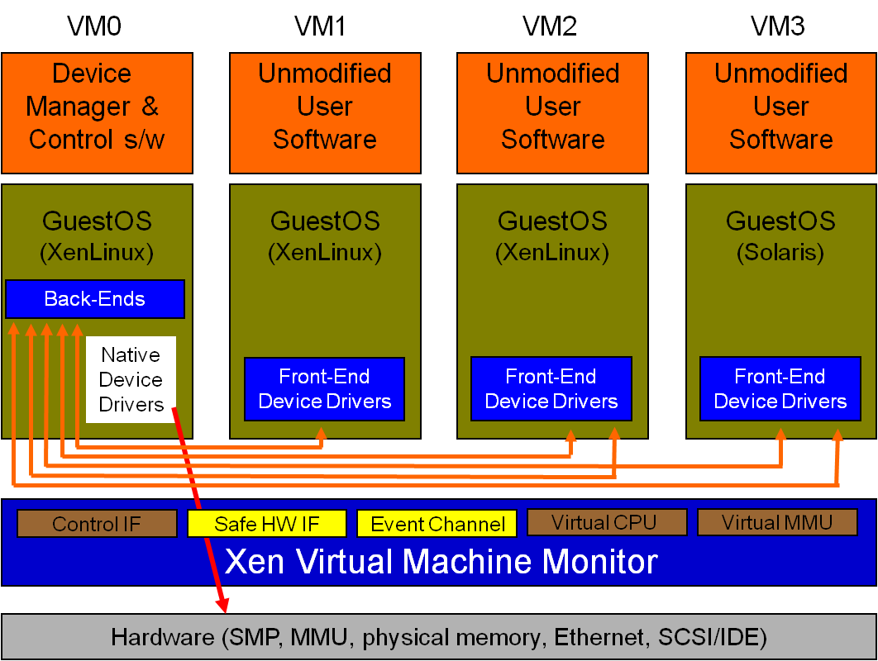
Original Xen Architecture

Slide 13
Hardware Assistance in Xen
Hardware assistance :
CPU provides VMExit for certain privileged instructions
Extend page tables used to virtualize memory
Xen features :
Enable Guest OS to be run without modification
For example, legacy Linux and Windows
Provide simple platform emulation
BIOS, apic, iopaic, rtc, Net (pcnet32), IDE emulation
Install para-virtualized drivers after booting for high-performance IO
Possibility for CPU and memory para-virtualization
Non-invasive hypervisor hints from OS

Slide 14
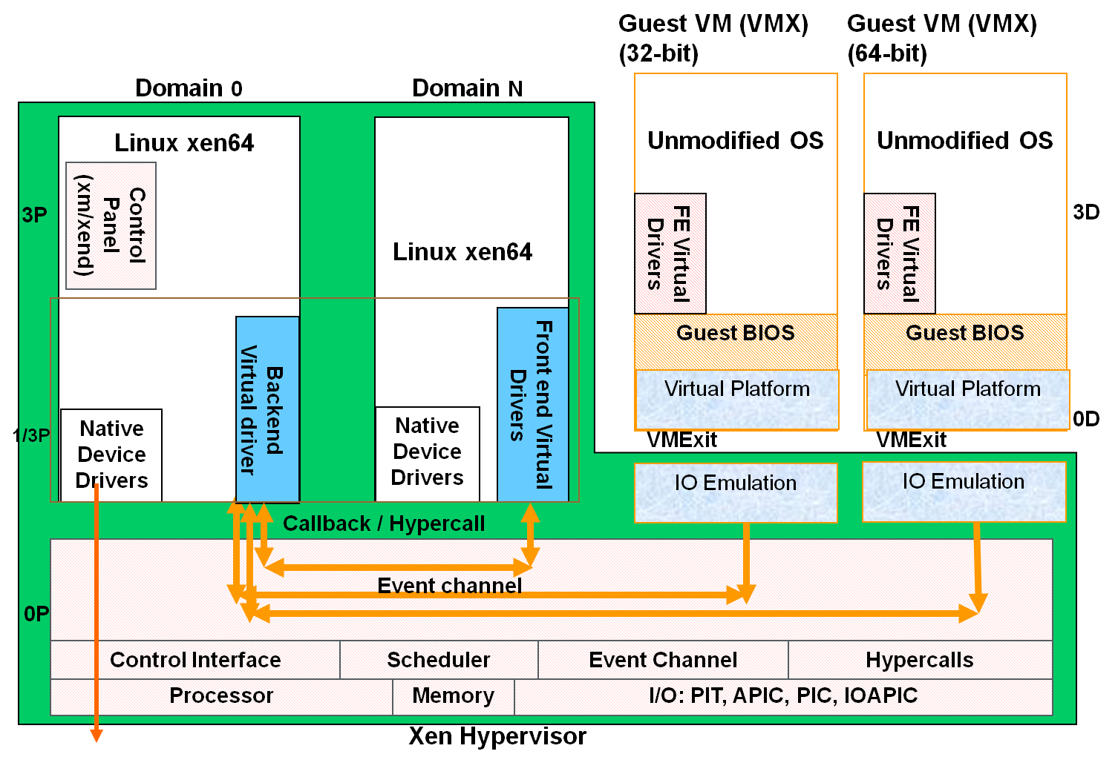
New Xen Architecture

Slide 15
KVM ON X86

Slide 16
KVM
KVM ( Kernel-based Virtual Machine)
Linux host OS
The kernel component of KVM is included in mainline Linux, as of 2.6.20.
Full-virtualization
KVM is a full virtualization solution for Linux on x86 hardware containing virtualization extensions (Intel VT or AMD-V).
Using KVM, one can run multiple virtual machines running unmodified Linux or Windows images.
IO device model in KVM :
KVM requires a modified QEMU for IO virtualization framework.
Improve IO performance by virtio para-virtualization framework.

Slide 17
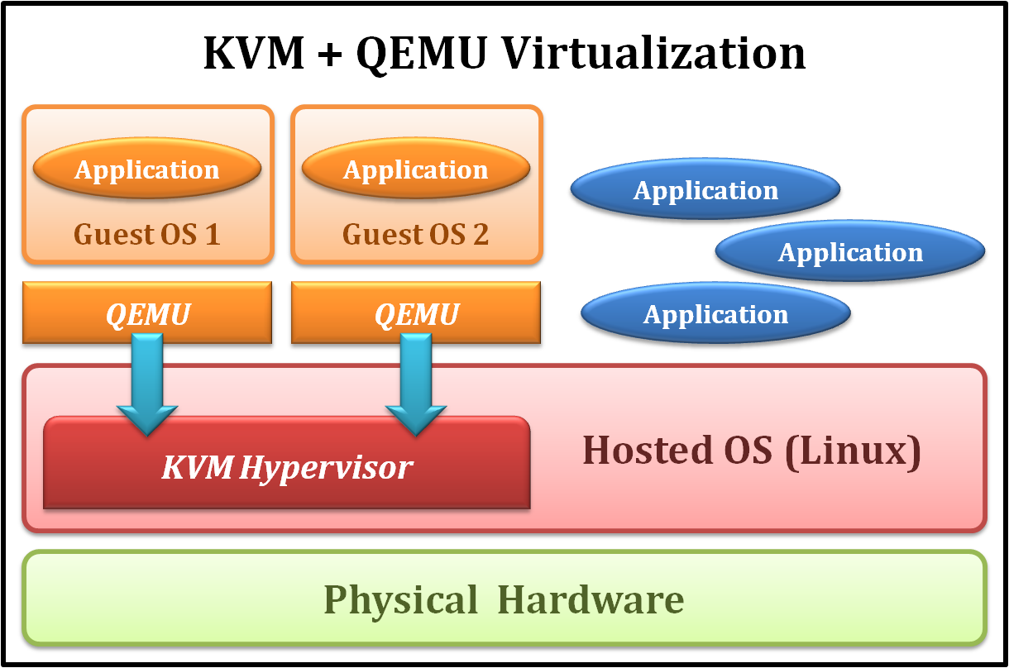
KVM Full Virtualization
It consists of a loadable kernel module
kvm.ko
provides the core virtualization infrastructure
kvm-intel.ko / kvm-amd.ko
processor specific modules

Slide 18
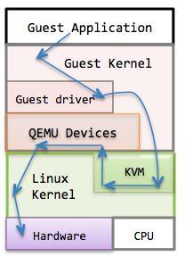
IO Device Model in KVM
Original approach with full-virtualization
Guest hardware accesses are intercepted by KVM
QEMU emulates hardware behavior of common devices
RTL 8139
PIIX4 IDE
Cirrus Logic VGA

Slide 19
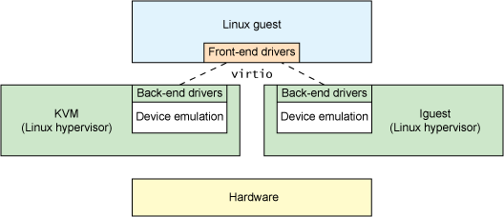
IO Device Model in KVM
New approach with para-virtualization

Slide 20
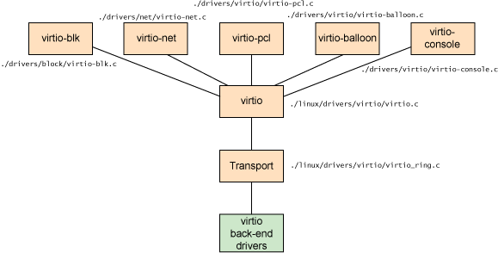
IO Device Model in KVM
virtio architecture

Slide 21
ARMvisor ON ARM

Slide 22
What is ARMvisor?
A KVM for ARM architecture
Technology:
Para-virtualization
Trap & Emulation
Dynamic Memory Allocation
virtio & IRQchip-in-kernel
Opensource under GNU GPLv2

Slide 23


Who are developers?
@

Slide 24
Overview of ARMvisor
QEMU-ARM
VM 0
VM 1
I/O
Virtualization
KVM-ARM Linux
Hypervisor
CPU Virtualization
MMU
Virtualization
CPU
MMU
Timer
I/O
Interrupt
Hardware

Slide 25
Overview of ARMvisor
CPU Virtualization
Methodology: Trap and Emulation
MMU
Virtualization
Methodology: Shadow Paging
I/O
Virtualization
Methodology: Userspace I/O Emulation

Slide 26
Software Stack of ARMvisor
Guest OS: Linux 2.6.35
QEMU 0.14
Driver
Device
Driver
ARMvisor
Host OS: Linux 2.6.38
Hardware: ARM Cortex-A8

Slide 27
User space
Kernel space
Guest Mode
1. VM initialization
2. Return to QEMU
3. Run VM
4. Enter Guest
5. Exit Guest
Lightweight trap
Enter Guest
Heavyweight trap
Exit Guest
Return to QEMU
Run VM
Enter Guest
QEMU
KVM
Guest OS
Notes:
In lightweight traps, the emulation is handled in internal functions of KVM which are implemented in the kernel space of Linux.
In contrast, heavyweight traps that include I/O accesses and parts of CPU functions will be handled in QEMU.
What’s more, QEMU is in Linux’s user space so context switches are required. Hence, the cost of a single heavyweight trap is relatively heavier than the lightweight one.

Slide 28
ARMvisor ON ARM
CPU Virtualization
Memory Virtualization
I/O Virtualization

Slide 29
CPU Virtualization
A classification of instructions of an ISA into 3 different groups:
Privileged instructions
Those that trap if the processor is in user mode and do not trap if it is in kernel mode
Sensitive instructions
Those that attempt to affect the resources in the system.
Critical instructions
Those are sensitive instructions but do not trap in user mode

Slide 30
CPU Virtualization
Critical
Instructions
Privileged
Instructions
Sensitive
Instructions
We need to emulate sensitive instructions and
carefully handled critical instructions

Slide 31
Sensitive Instruction Emulation
Classify sensitive, privilege and critical instructions for ARM ISA
Implement an sensitive instruction emulation engine
How to handle critical instructions?
Lightweight Para-virtualization
Pre-Insert swi #
Few of guest kernel codes are patched

Slide 32
ARM Instruction Classification
S | C | P | Instruction Type | Operation | Behavior | Emulation
✓ | ✓ |  | Data-processing | ADCS, ADDS, ANDS, BICS, EORS, MOVS, MVNS, ORRS, RSBS, RSCS, SBCS, SUBS | CPSR ← SPSR | Status Register Access
✓ | ✓ |  | Status register access | MRS | GPR ← CPSR/SPSR
 |  |  |  | MSR | CPSR/SPSR ← GPR
 |  |  |  | CPS | CPSR ← CPS (A|I|F|Mode)
✓ | ✓ |  | Extended | RFE | (CPSR, PC) ← MEM
 |  |  |  | SRS | MEM ← (SPSR, R14)
✓ | ✓ |  | Load and Store Multiple | LDM(3) | CPSR ← SPSR
 |  |  |  | LDM(2) | USR_REGS ← MEM | Bank Register Access
 |  |  |  | STM(2) | MEM ← USR_REGS
✓ | ✓ |  | Load and Store | LDRT/LDRBT | GPR ← MEM (User Permission) | User Permission Access
 |  |  |  | STRT/STRBT | MEM ← GPR (User Permission)
✓ |  | ✓ | Coprocessor | CDP/CDP2, LDC/LDC2, MCR/MCR2, MCRR/MRRC2, MRC/MRC2, MRRC/MRRC2, STC/STC2 | Call CORP COPR ← MEM/GPR MEM/GPR ← CORP | Coprocessor Access

Slide 33
Patched Guest Kernel Codes
Patched Souse Code | LOC | Emulation
arch/arm/boot/compressed/head.S arch/arm/include/asm/assembler.h arch/arm/include/asm/irqflags.h arch/arm/include/asm/kvm-asm.h arch/arm/include/asm/kvmguest.h arch/arm/kernel/asm-offsets.c arch/arm/kernel/entry-armv.S arch/arm/kernel/entry-common.S arch/arm/kernel/head.S arch/arm/kernel/setup.c arch/arm/kernel/traps.c arch/arm/mm/abort-ev6.S arch/arm/mm/proc-macros.S arch/arm/mm/proc-v6.S | 6 71 99 154 20 12 74 20 4 6 14 5 4 6 | Status Register Access Bank Register Access Coprocessor Access
arch/arm/include/asm/futex.h arch/arm/include/asm/uaccess.h arch/arm/lib/clear_user.S arch/arm/lib/copy_from_user.S arch/arm/lib/copy_to_user.S arch/arm/lib/csumpartialcopyuser.S arch/arm/lib/getuser.S arch/arm/lib/putuser.S arch/arm/lib/strnlen_user.S arch/arm/lib/uaccess.S arch/arm/nwfpe/entry.S | 3 6 8 1 1 10 4 8 1 11 1 | User Permission Access
Total | 549

Slide 34
Para-virtualization
…
mov r0, r0
add sp, sp
movs pc, lr
…
Notes:
Let’s see an example about the Para-virtualization implementation. On the screen is a partial assembly code in guest OS source code. The third line “movs pc lr”would update PC value so it’s obviously a sensitive instruction. Actually it’s a critical instruction so our goal is trying to make it trap to the VMM.

Slide 35
Para-virtualization
.macro virt_svc_movs, inst
SWI 0x190
\inst
.endm
…
mov r0, r0
add sp, sp
virt_svc_movs “movs pc, lr”
…
We replace the instruction with a self-defined macro. The original instruction is the parameter of the macro. This macro would send a software interrupt to VMM. When receiving the SWI number 0x190, VMM has the knowledge that the next instruction is a instruction which should be emulated.
Notes:
We replace the instruction with a self-defined macro. The original instruction is the parameter of the macro. This macro would send a software interrupt to VMM. When receiving the SWI number 0x190, VMM has the knowledge that the next instruction is a instruction which should be emulated.

Slide 36
UND
ABORT
SWI
IRQ/FIQ
KVM Trap Entry
Host Trap Handler
KVM/Guest
Context Switch
Unit
KVM Trap Dispatcher
Instruction Emulation
MMU Emulation
Exception/Interrupt Emulation
QEMU I/O
Emulation

Slide 37
Vector
0x1C | FIQ
0x18 | IRQ
0x14 | (Reserved)
0x10 | Data Abort
0x0C | Prefetch Abort
0x08 | Supervisor Call
0x04 | Undef. Instr.
0x00 | Reset
oxffff1000
0xffff001c
Kernel Vector
oxffff0000
Notes:
有一個exception vector table在一班的OS裡面，用來重新導向不同的trap到相對應的處理者

Slide 38
KVM Vector
The KVM trap
Interface
oxffff1000
0xffff001c
KVM
Vector
oxffff0000
Notes:
We imitate this mechanism. We design a KVM vector, and the KVM vector would re-direct traps to the KVM trap interface which is placed at address 0xffff1000 in another shared page. The exception trap to this vector would be re-direct to the interface for later handling.

Slide 39
CPU Virtualization Overhead
CPU virtualization
Frequent lightweight traps result in lots of context switch
Try to reduce…
number of traps
Overhead of emulation
Notes:
In our measurement, parts of critical instructions only involve in virtual state and no hardware modification is needed.
As a result, instead of trapping such instructions, we have an idea that let these instructions execute in guest address space.
Other parts of sensitive instructions must be executed in privileged mode, that is, it must be trapped to host when emulation. The optimization policy of CPU virtualization is to reduce the number of traps and the overhead of emulation.

Slide 40
Optimizations for CPU Virtualization
Dynamic View
Which sensitive instructions are frequently used by the guest OS in the ARM architectures?
What activities are these frequently-used sensitive instructions used in?
Optimizations
Reduce instruction emulation overhead / traps
Shadow register file
Sensitive instruction grouping
TLB/Cache trap overhead reduction

Slide 41
CPU Optimization Methods
Operations that read the information in co-processor are replaced by SRFA (shadow register file access).
TLB operations and BTB flush in guest are replaced by NOP.
FIT (fast instruction trap) is applied to reduce costs of context switch.
Notes:
要解決的問題

Slide 42
CPU Optimization
Shadow file register (SFR)
Map VCPU’s shadow state of the register file into memory region that is both accessible for the VMM and guest with RW permission.
Notes:
We proposed shadow register file which …… it’s a little bit hard to understand the literal meaning of this sentence. Here comes a figure.

Slide 43
Shadow Register File Optimization
Shadow file register (SFR)
Map VCPU’s shadow state of the register file into memory region that is both accessible for the VMM and guest with RW permission.
Hypervisor
Guest
VCPU
Register
File
Guest
Sensitive
Instructions
Trap
Sensitive Instruction
Emulation Engine

Slide 44
Shadow Register File Optimization
Hypervisor
Guest
VCPU
Register
File
Sync
Shadow
Register
File
Guest
Sensitive
Instructions
Sensitive Instruction
Emulation Engine

Slide 45
Sensitive Instruction Grouping Optimization
Guest Kernel uses the vector_stub to handle interrupt/trap
Many sensitive instructions are used in the small code segment
.macro vector_stub, name, mode, correction=0
stmia sp, {r0, lr}
mrs lr, spsr
str lr, [sp, #8]
mrs r0, cpsr
eor r0, r0, #(\mode ^ SVC_MODE | PSR_ISETSTATE)
msr spsr_cxsf, r0
and lr, lr, #0x0f
mov r0, sp
movs pc, lr
Sensitive Instructions

Slide 46
Sensitive Instruction Grouping Optimization
Grouping the small code segment by one hypercall
.macro vector_stub, name, mode, correction=0
hypercall(vector_stub)

Slide 47
TLB/Cache Trap Optimization
Originally, the instruction emulation path is too long!
Hypervisor
Guest
Enter System Mode
TLB and Cache
Instructions
Assembly
Code
Trap
Context Switch
Handler
Dispatcher
C
Sensitive Instruction
Emulation Engine
TLB/Cache Instruction Emulation

Slide 48
TLB/Cache Trap Optimization
After optimization, the overhead of TLB/Cache trap is reduced
Hypervisor
Guest
Enter System Mode
TLB and Cache
Instructions
Assembly
Code
Trap
Fast Emulation
Engine

Slide 49
CPU Optimization
Base
Trap all sensitive instructions
VCPU v0.1 Model
R Sharing: guest directly READ virtual registers
VCPU v1.0 Model
R/W Sharing: guest directly R/W virtual registers
Sensitive instruction grouping
TLB/Cache trap overhead reduction

Slide 50
Sensitive Instr. Trap Reduction
 | base version | CPU_OPT_V0.1 | CPU_OPT_V1.0
Guest sum_exits | 15536 | 8567 | 3788
Guest light_exits | 15318 | 8396 | 3555
Guest heavy_exits | 218 | 171 | 233
sensitive inst exits | 12679 | 5855 | 658
mls | 355 | 356 | 359
msr | 1567 | 1529 | 42
mrs | 1606 | 298 | 0
cps | 1842 | 1484 | 6
data | 317 | 318 | 167
copr | 6990 | 1868 | 84
ls | 286 | 171 | 402
LS (T or PT write) | 68 | 0 | 169
MMIO | 218 | 171 | 233
Total Instr Emulation | 12965 | 6026 | 1060
75.62%
76.79%
94.81%
100%
99.67%
98.80%

Slide 51
ARMvisor ON ARM
CPU Virtualization
Memory Virtualization
I/O Virtualization

Slide 52
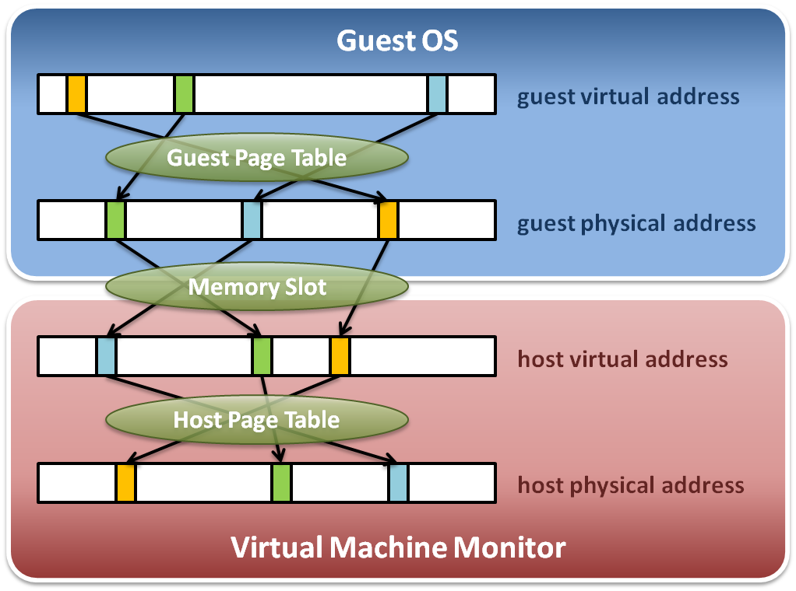
Memory Virtualization on X86
Memory virtualization architecture

Slide 53
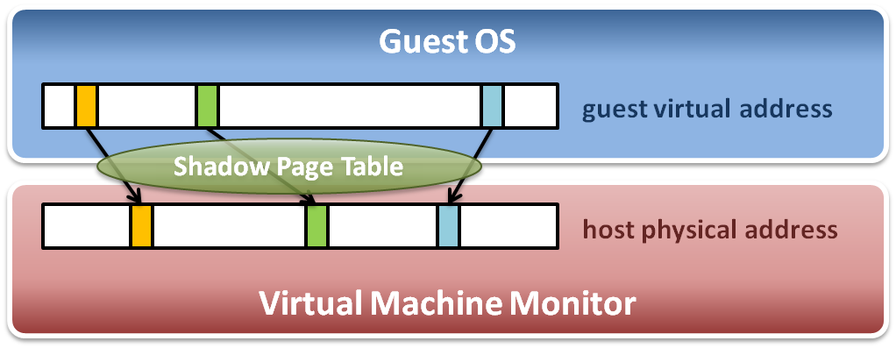
Memory Virtualization on X86
The performance drop of memory access is usually unbearable. VMM needs further optimization.
VMM maintains shadow page tables :
Direct virtual-to-physical address mapping
Use hardware TLB for address translation

Slide 54
MMU Virtualization on ARM
Overview
Guest
vCPU
GVA
vMMU
GPA
MMU
Virtualization
Guest Physical Memory
HPA
Host Physical Memory

Slide 55
MMU Virtualization on ARM
Dynamic physical memory allocation to guest
Software MMU Virtualization
Simulate a real ARMv6 ot v7 MMU
Build up Shadow page table
Synchronization between Guest page table and Shadow page table

Slide 56
Dynamic Physical Memory Allocation to Guest
Host
Virtual
Memory
Guest
Physical
Memory
Host
Physical
Memory
Guest physical memory pages are allocated dynamically at runtime.

Slide 57
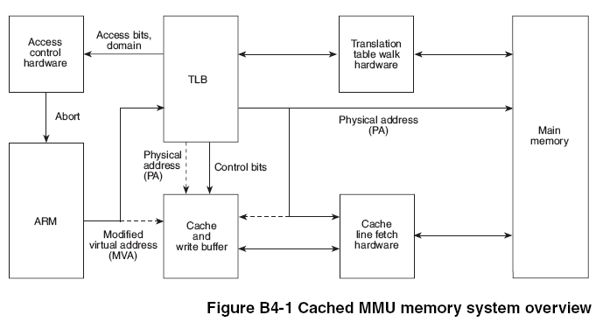
Software MMU Virtualization (1)
MMU Virtualization will behave as a real MMU chip to build up page table.
2
1
Page Table
3
Real MMU Chip

Slide 58
Software MMU Virtualization (2)
Software MMU Virtualization Processes
PABT / DABT
Trap
Real MMU Behavior
Shadow Table Behavior
1
2
3
Initial
Synchronization
Guest
Page Table
Walker
Guest
Permission
Checker
MMIO
Access
Checker
Shadow Page Table
Mapping
Shadow Page Table
Update
True permission fault
Hidden translation fault
True translation fault
MMIO emulation

Slide 59
Step 1
While page fault is occured, Guest Page Table Walker will walk through guest page table to check if the fault is from guest.
PABT / DABT
Trap
1
Guest
Page Table
Walker
Guest
Permission
Checker
MMIO
Access
Checker
Shadow Page Table
Mapping
Shadow Page Table
Update
True permission fault
Hidden translation fault
True translation fault
MMIO emulation

Slide 60
Step 2
Step 2 will check if guest access permission is not allowed.
PABT / DABT
Trap
2
Guest
Page Table
Walker
Guest
Permission
Checker
MMIO
Access
Checker
Shadow Page Table
Mapping
Shadow Page Table
Update
True permission fault
Hidden translation fault
True translation fault
MMIO emulation

Slide 61
Step 3
Step 3 will check if the guest physical memory address used is located in the range of MMIO address.
PABT / DABT
Trap
3
Guest
Page Table
Walker
Guest
Permission
Checker
MMIO
Access
Checker
Shadow Page Table
Mapping
Shadow Page Table
Update
True permission fault
Hidden translation fault
True translation fault
MMIO emulation

Slide 62
Steps 4 & 5
Step 4 and step 5 are used to build up shadow page tables and maintain their consistency between guest and shadow ones.
PABT / DABT
Trap
4
5
Guest
Page Table
Walker
Guest
Permission
Checker
MMIO
Access
Checker
Shadow Page Table
Mapping
Shadow Page Table
Update
True permission fault
Hidden translation fault
True translation fault
MMIO emulation

Slide 63
Build Up Shadow Page Table
Context switch
New process
Access
Process
Page Table
Process
Page Table
Process
Page Table
Virtual TTPR
Guest OS
Real TTPR
VMM
Page fault !
Shadow
Page Table
Shadow
Page Table
Shadow
Page Table
Load !
Corresponding mapping table
Switch the pointer to new location
Create new shadow page table mapping to new process

Slide 64
MMU Virtualization Optimization
Guest kernel space mapping sharing
Reduce guest page table synchronization overhead

Slide 65
Guest kernel space mapping sharing
Kernel space
Kernel space
User space
User space
Guest Process 1
Guest Process 2
Shadow table
Kernel space
Shadow table
The shadow tables of kernel space
are shared by all guest processes
User space
Shadow table

Slide 66
Reduce guest page table synchronization overhead
We use para-virtualization to inform hypervisor when guest would like to change guest page table
This method will eliminate from using write-protection for synchronization

Slide 67
ARMvisor ON ARM
CPU Virtualization
Memory Virtualization
I/O Virtualization

Slide 68
Emulate by QEMU

Slide 69
I/O Virtualization Flow
Interrupt
Storage
Timer
UART
Network
QEMU-ARM
Guest OS
User Space
I/O Result
R/W MMIO
I/O Response
I/O Request
Trap
Kernel Space
KVM-ARM
I/O Access
ARM Architecture

Slide 70
virtio

Slide 71
What is virtio
Virtio is an idea from IBM to improve I/O virtualization.
An I/O abstraction layer
Provide a set of APIs and structures

Slide 72
Why it fast
Guest share a memory space with QEMU, so that the data can be accessed by each sides.
Furthermore, the number of MMIOs can be reduced by using VirtQueue.

Slide 73
Virtio Driver
Guest
Virtio AMBA Controller
Vring
Transport
Virtio AMBA Controller
QEMU
Virtio Device

Slide 74
Devices & Drivers
Virtio supports Block, Network, Serial, and Ballon devices right now.
In addition, these drivers already built-in in Linux Kernel.

Slide 75
irq_chip in kernel

Slide 76
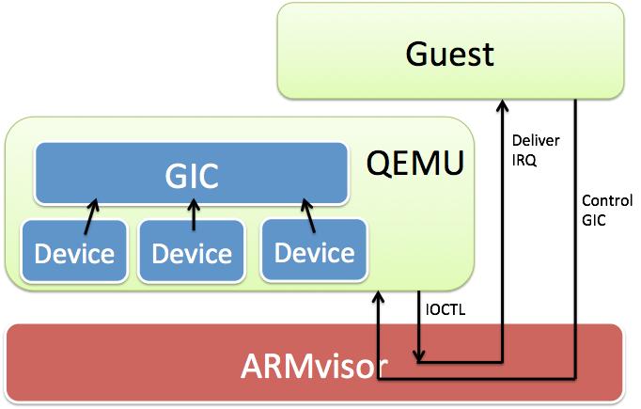
irq_chip in kernel

Slide 77
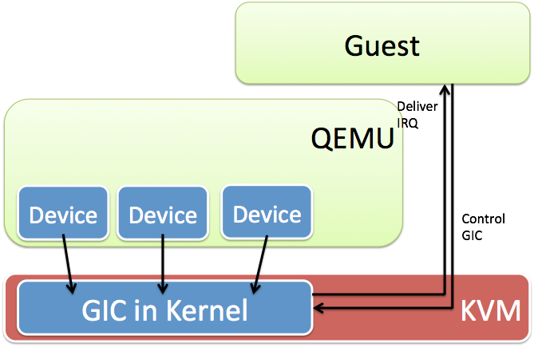
irq_chip in kernel

Slide 78
Why it useful
The MMIO request is no longer need to deliver to QEMU. That is to say, the type of trap is changed from heavy-wirght trap to light-weight trap.

Slide 79
References
Web resources :
Xen project http://www.xen.org
KVM project http://www.linux-kvm.org/page/Main_Page
IBM VirtIO survey https://www.ibm.com/developerworks/linux/library/l-virtio
PCI-SIG IO virtualization specification http://www.pcisig.com/specifications/iov
Paper & thesis resources :
Jiun-Hung Ding, Chang-Jung Lin, Ping-Hao Chang, Chieh-Hao Tsang, Wei-Chung Hsu, Yeh-Ching Chung, "ARMvisor: System Virtualization for ARM", Linux Symposium
林長融，ARMvisor IO 效能最佳化及分析，以 Virtio 及 irqchip 為例，國立清華大學，碩士論文，2012
Other resources :
Lecture slides of “Virtual Machine” course (5200) in NCTU
Lecture slides of “Cloud Computing” course (CS5421) in NTHU
Vmware Overview Openline presentation slides http://www.openline.nl
Xen presentation http://www.cl.cam.ac.uk/research/srg/netos/papers/2006-xen-fosdem.ppt

Slide 80
I/O Virtualization
Currently, ARM I/O Emulations are supported by QEMU-ARM

Slide 81
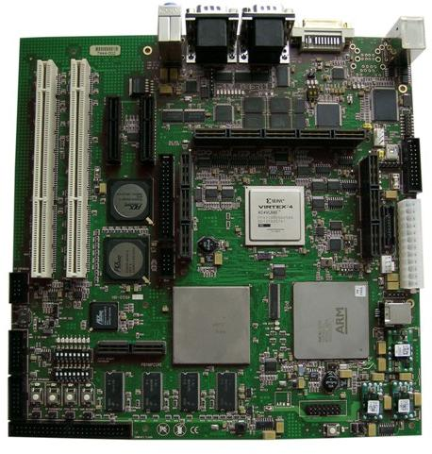
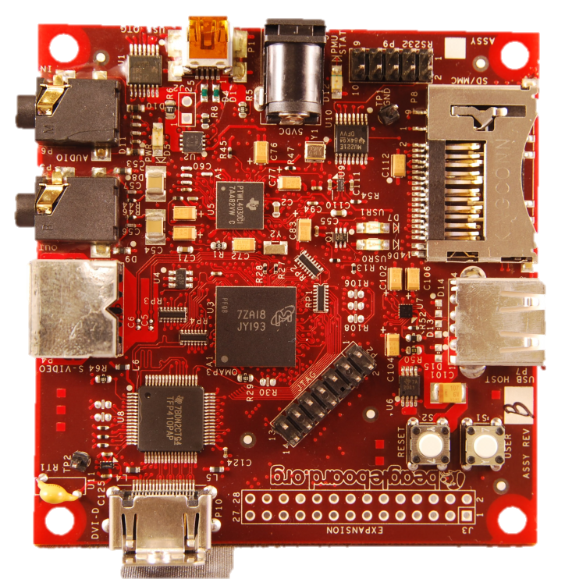


Support ARMv6 & ARMv7 architecture
ARM v6 11mpcore
ARM v7 cortex-a8

